Slide 1
Retail Management System
CC0 1 - Group 1
Lê Đức Cầm - 1952588
Phạm Mạnh Dũng - 1952633
Nguyễn Tiến Dương - 1952639

Slide 2
Tables of content
1.Normal form in DBMS
2. Complete implementation
3.Database security
4.Tool for tuning and mainipulating DB
5.Demo and conclusion

Slide 3


Normal form
Discuss
Definition of NF
Advantage of NF

Slide 4
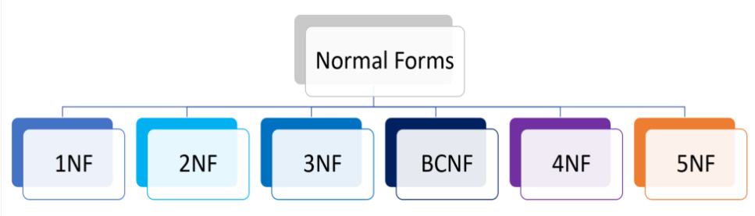
Normal form
2. Improve DB design using NF

Slide 5

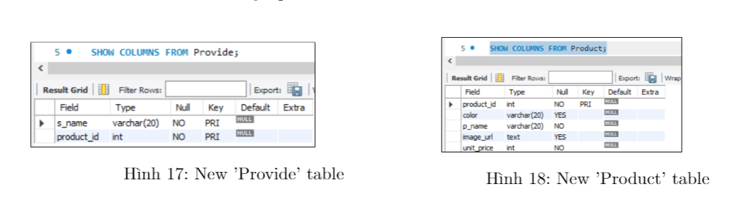
Completion of implementation
Progress
Already finish
But need some small change

Slide 6
Discuss about database security
1. What is Database Security?
Database Security secure database management systems from malicious cyber-attacks and illegitimate use
Must address and protect the following:
+ The data in the database
+ The database management system
+ Any associated applications
+ The physical/virtual database server and the underlying hardware
+ The computing and/or network infrastructure used to access the database

Slide 7
Discuss about database security
2. Database Security Threats
Insider Threats
Human Error
Exploitation of Database Software Vulnerabilities
SQL/NoSQL Injection Attacks
Buffer Overflow Attacks
Denial of Service (DoS/DDoS) Attacks
Malware
Loss of integrity/ availability/ confidentiality

Slide 8
Solutions and security mechanism
Actively Manage Passwords and User Access
Test Our Database Security
Use Real-Time Database Monitoring
Use Web Application and Database Firewalls
Access control
Inference control
Flow control
Data encryption

Slide 9
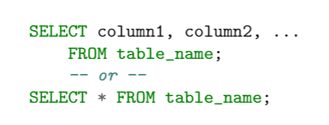
Simple to complex queries
Syntax of normal query

Slide 10
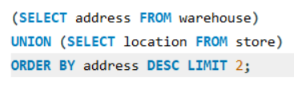
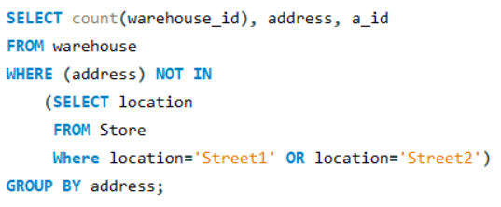
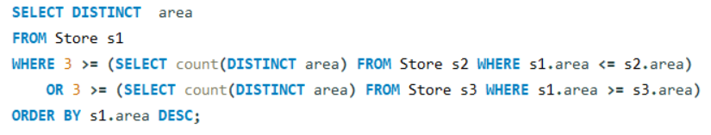
Simple to complex queries
Some complex query
Purpose of using complex query
Combine query with multiple constraints

Slide 11
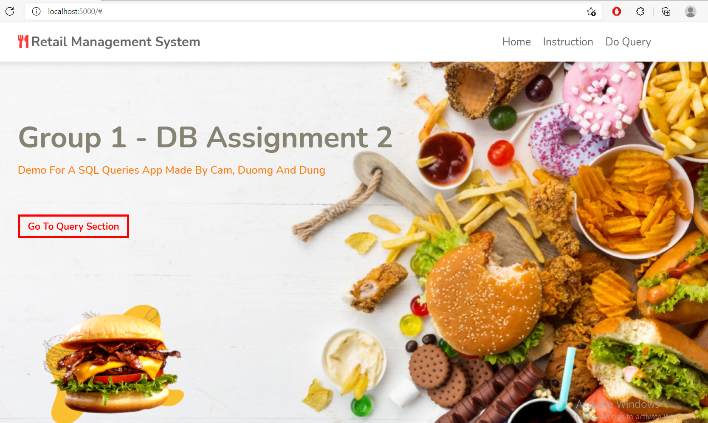

Demonstration with app

Slide 12



Conclusion

Slide 13
Thanks for your listening
If you have any questions , don’t hesitate to ask us <3

